Slide 1
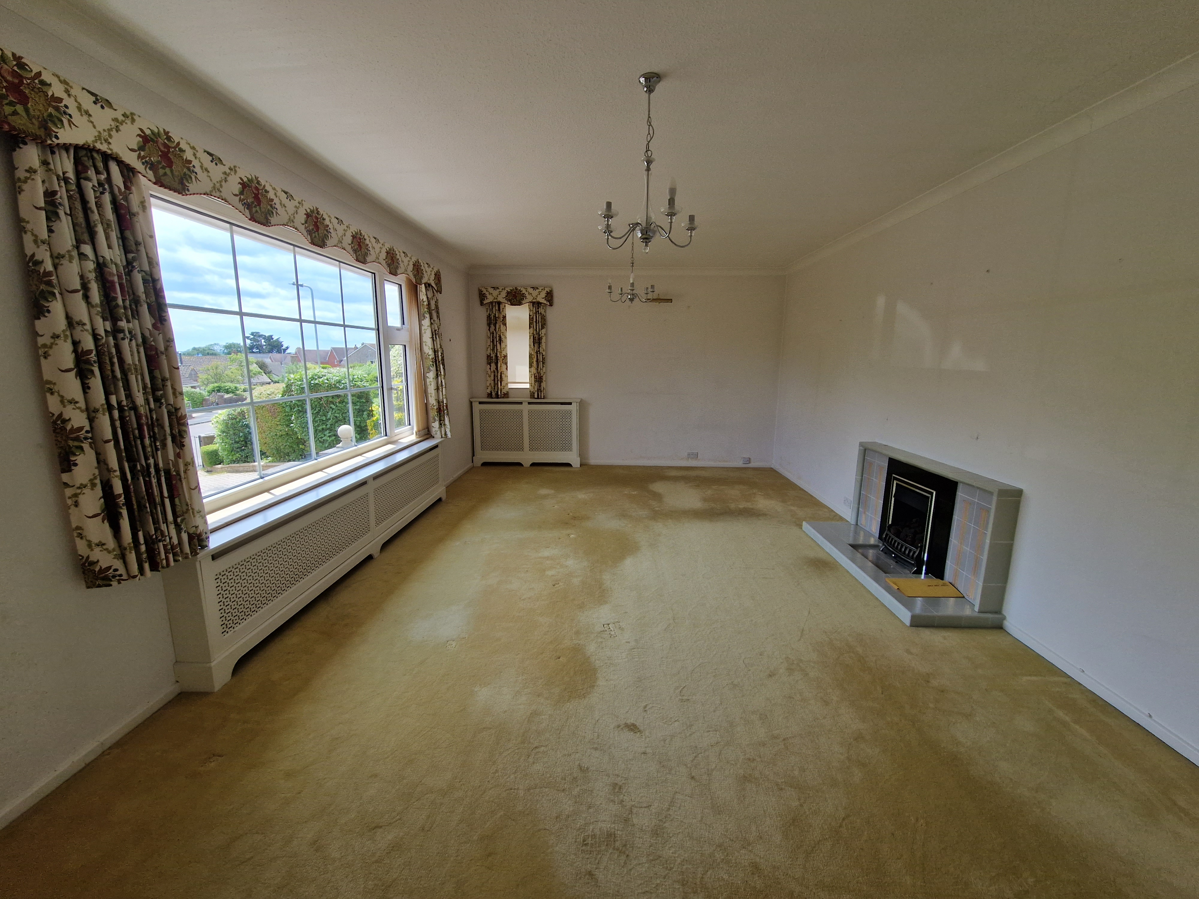
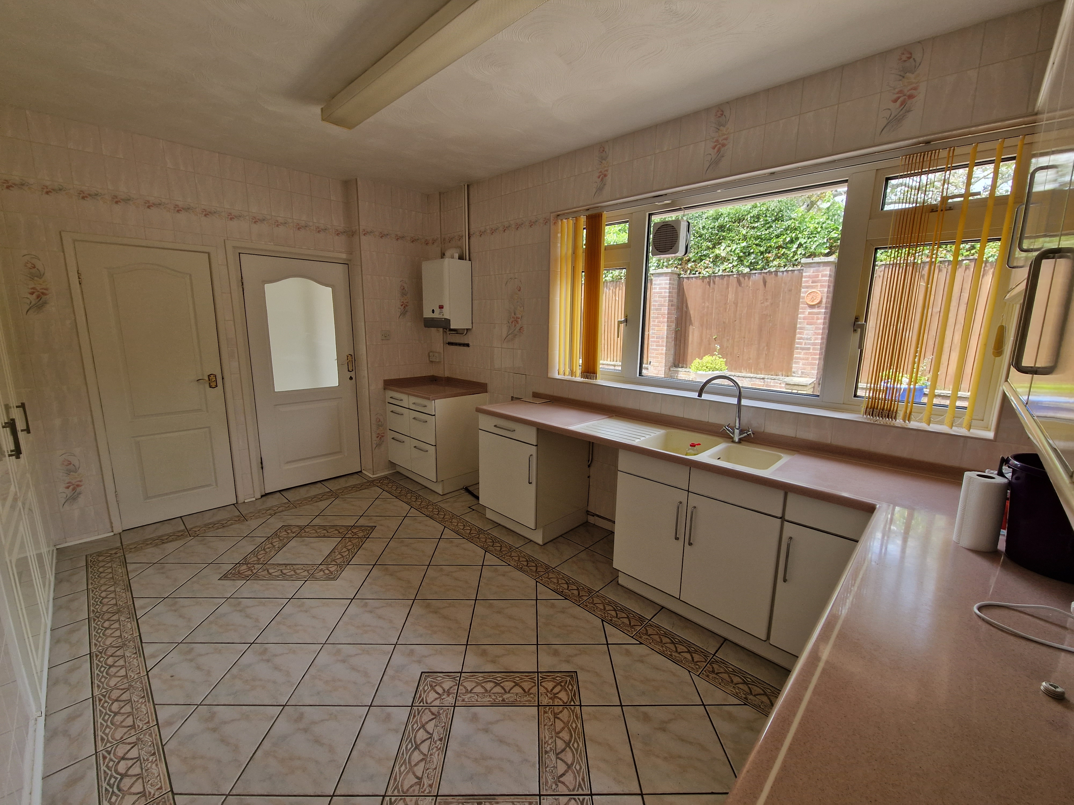
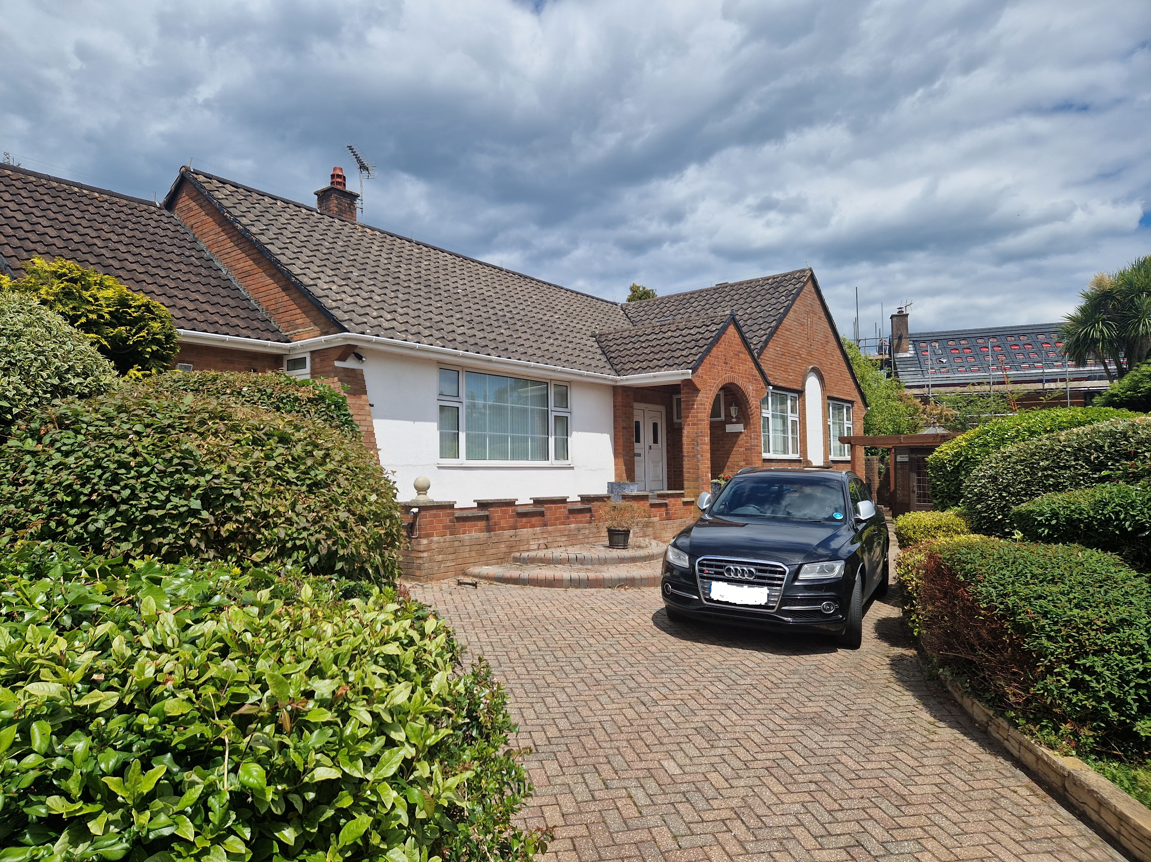
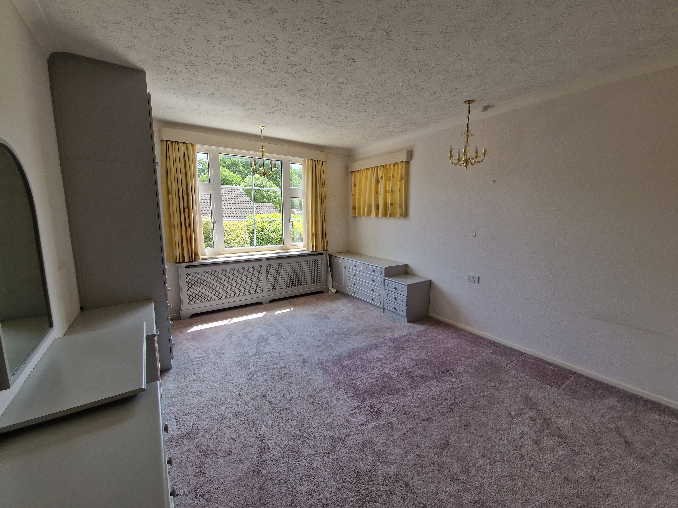
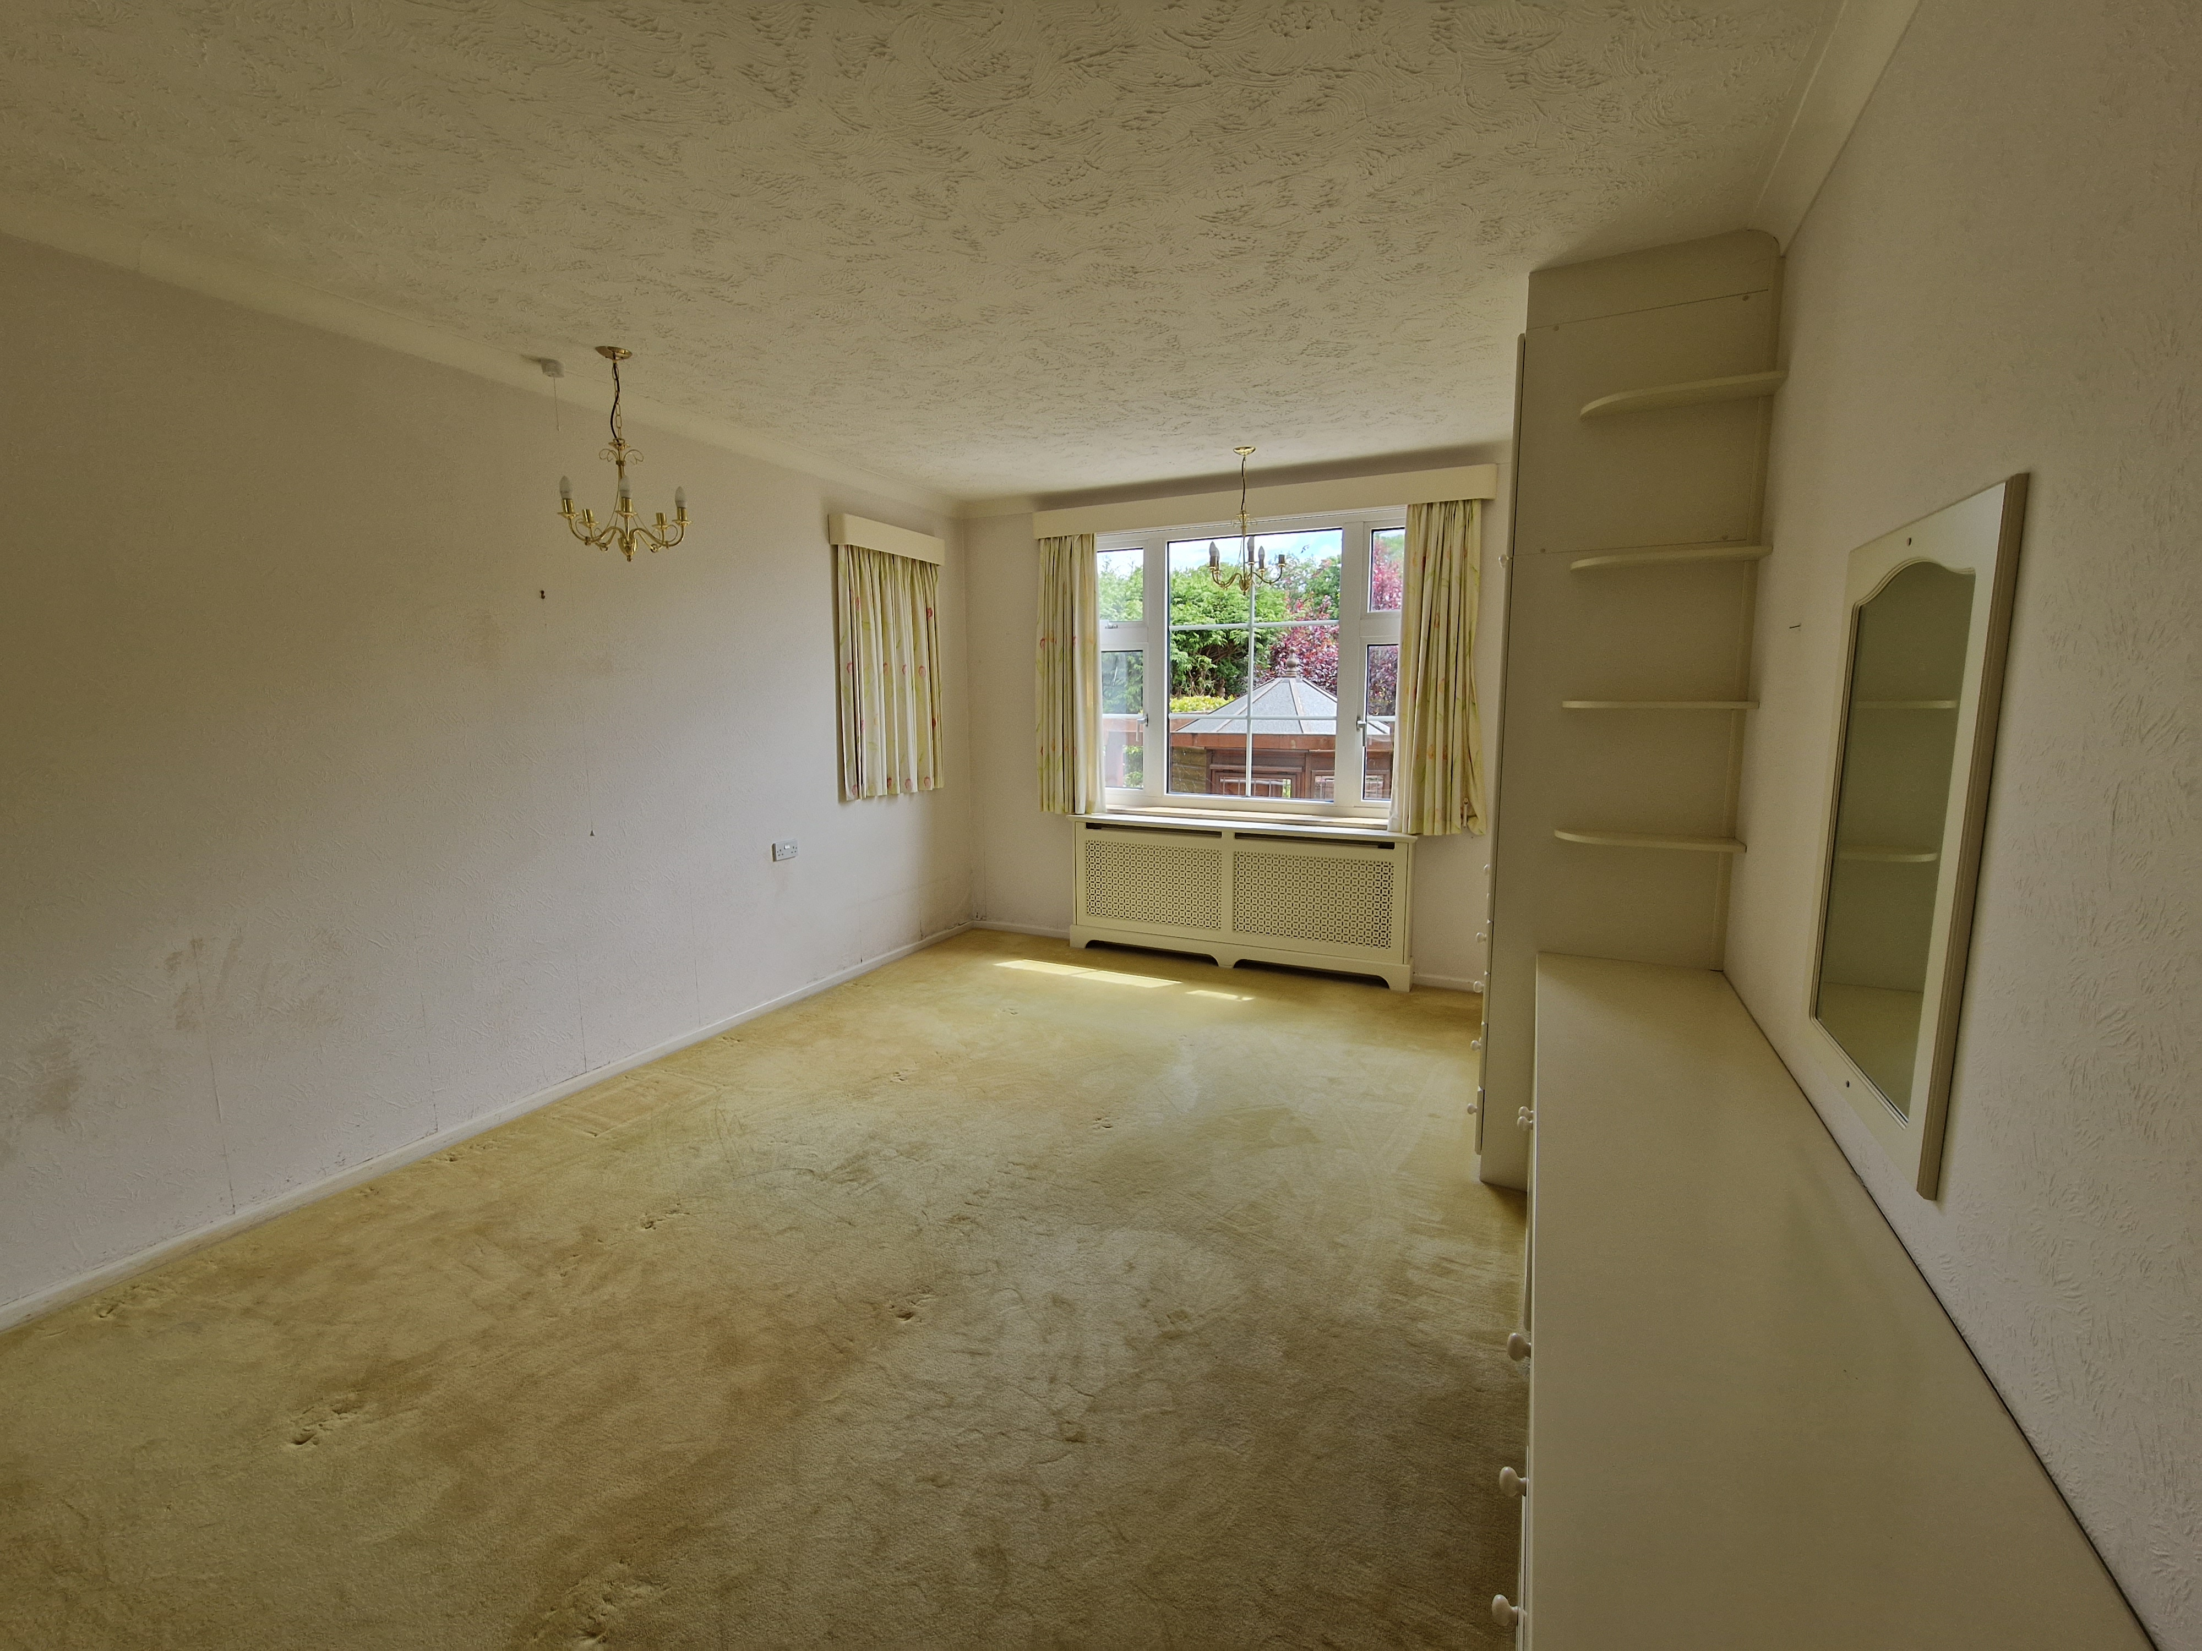
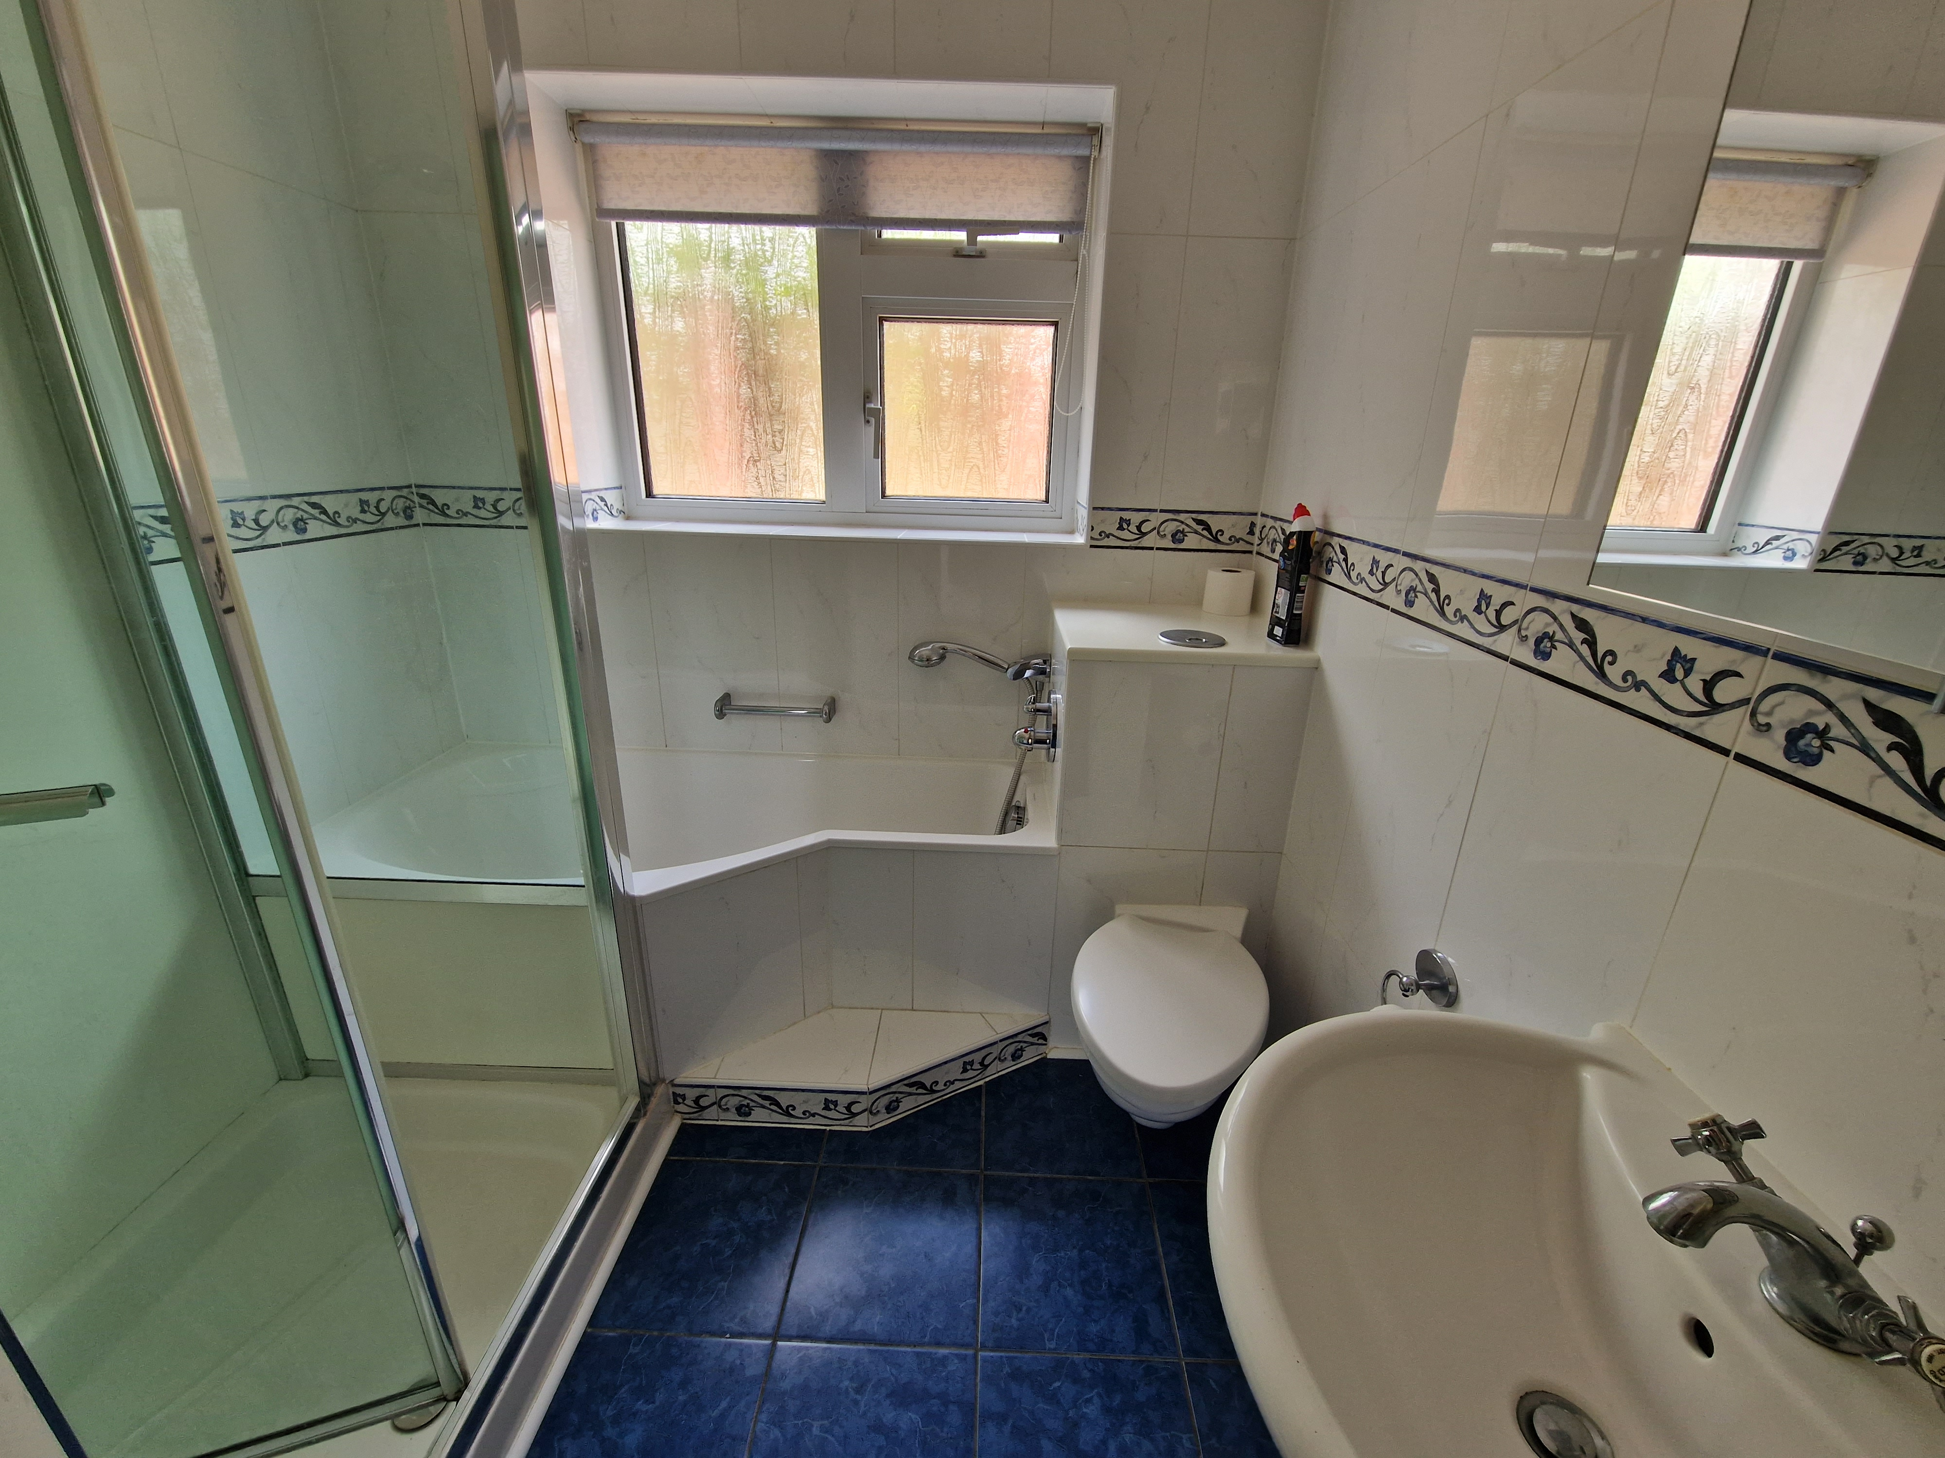
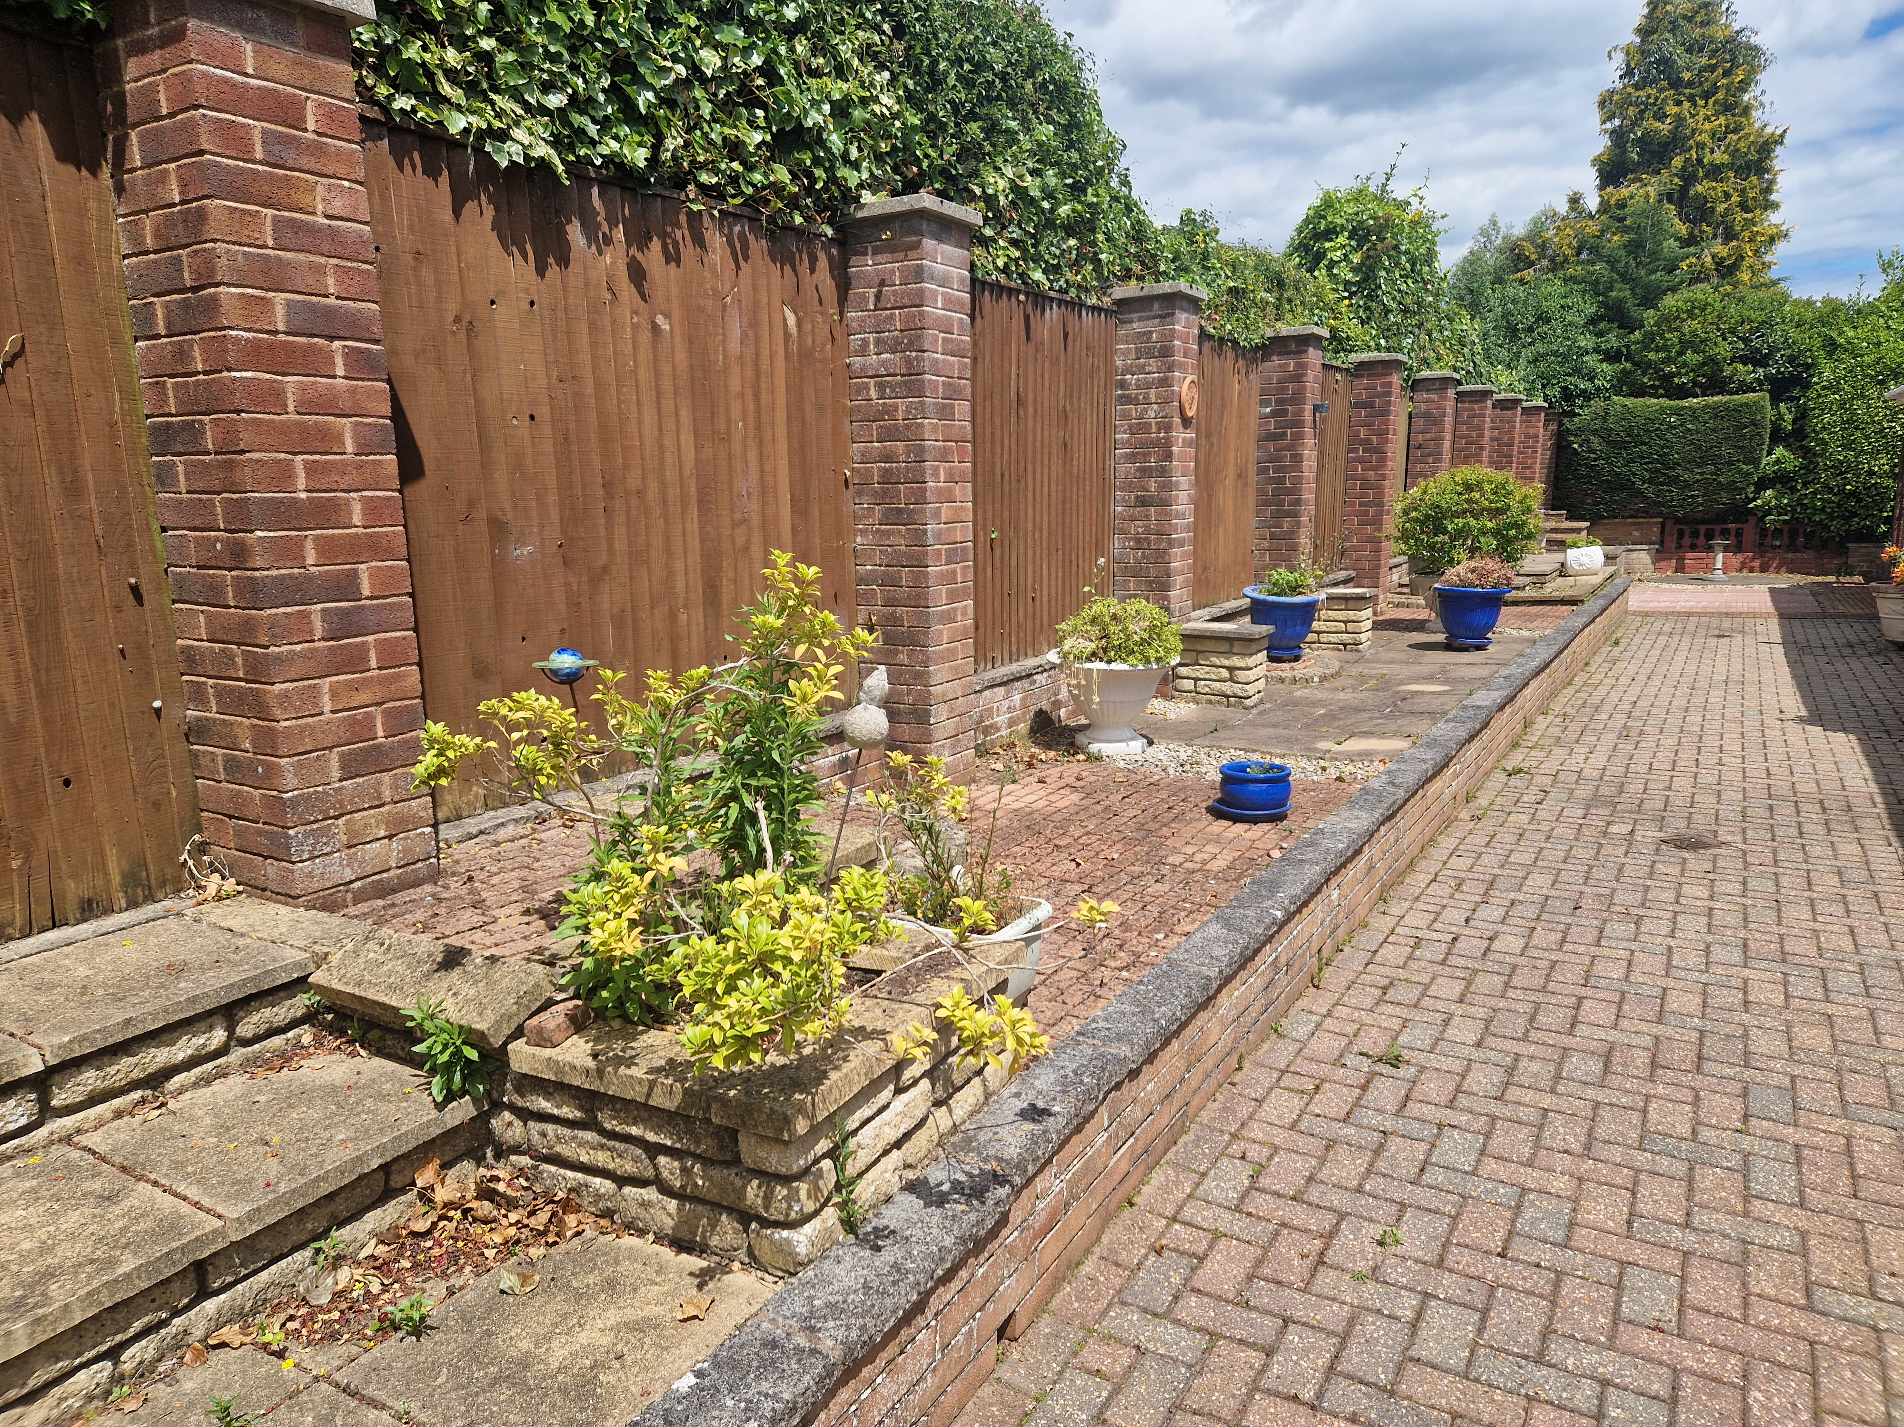
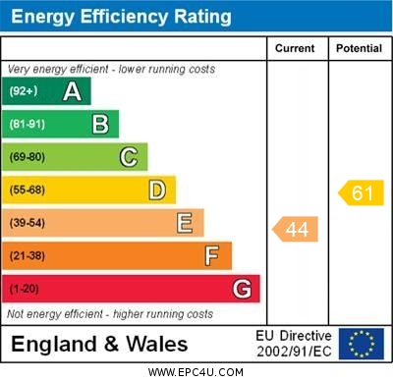
www.pennys.net
7 Maer Vale, Exmouth, EX8 2DX
GUIDE PRICE £800,000
TENURE Freehold
An Individually Built Detached Bungalow Located At The Head Of A Desirable Cul-De-Sac Just A Short Walk From The Seafront And Town Centre
Extremely Spacious Accommodation * Entrance Porch And Reception Hall * Large Lounge * Separate Dining Room * Kitchen/Breakfast Room * Three Bedrooms * Bathroom/Wc * Cloakroom/Wc * Large Boarded Attic * Ample Parking And Garage * Manageable Gardens * No Ongoing Chain
Pennys Estate Agents Limited for themselves and for the vendor of this property whose agents they are give notice that:- (1) These particulars do not constitute any part of an offer or a contract. (2) All statements contained in these particulars are made without responsibility on the part of Pennys Estate Agents Limited. (3) None of the statements contained in these particulars are to be relied upon as a statement or representation of fact. (4) Any intending purchaser must satisfy himself/herself by inspection or otherwise as to the correctness of each of the statements contained in these particulars. (5) The vendor does not make or give and neither do Pennys Estate Agents Limited nor any person in their employment has any authority to make or give any representation or warranty whatever in relation to this property.
PENNYS ESTATE AGENTS
2 Rolle House, Rolle Street, Exmouth, Devon, EX8 2SN
Tel: 01395 264111 EMail: help@pennys.net

Slide 2
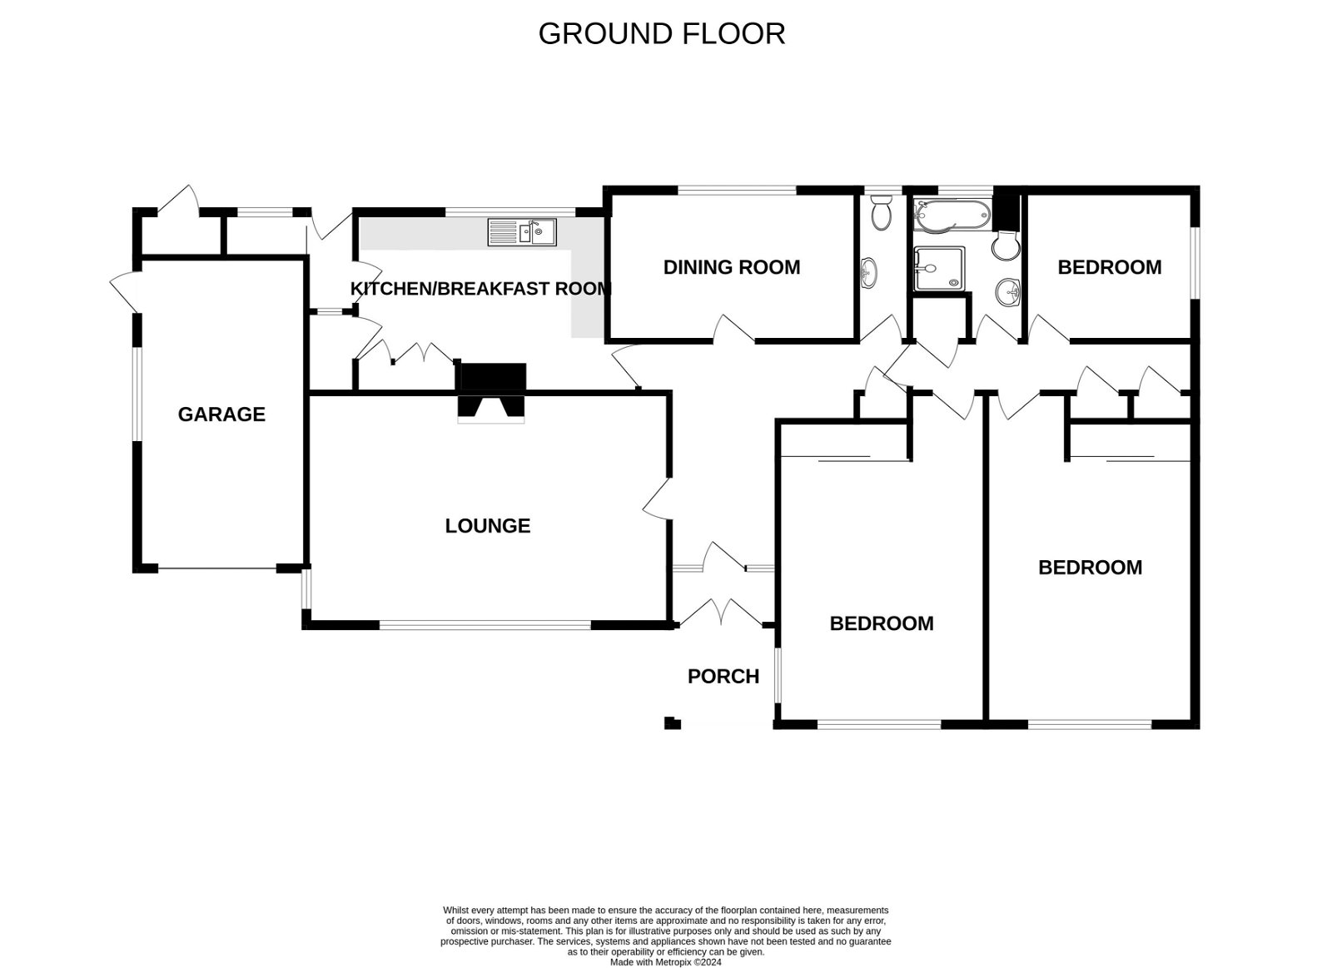
7 Maer Vale, Exmouth, EX8 2DX
Pennys are delighted to offer for sale this extremely spacious detached bungalow in one of Exmouth’s most desirable areas just a short distance of both the town centre and seafront. Individually built we understand by Messrs Francis Williams Limited, the property commands an impressive position and is approached via double wrought iron gates to sweeping block paved driveway and garage. The accommodation requires some general refurbishment, is both bright and spacious with three bedrooms, large lounge, separate dining room, kitchen/breakfast room, bathroom/wc and separate cloakroom/wc. Offered with no ongoing chain, viewing is highly recommended.
THE ACCOMMODATION COMPRISES: Impressive bricked arch entrance with courtesy light, uPVC double doors giving access to entrance porch with inner glazed panel door and picture windows to either side giving access to:
SPACIOUS RECEPTION HALL: A fine entrance to the property with radiator with radiator cover, access to large boarded loft space via ladder with two modern velux windows, power and light connected (This area could be converted to additional accommodation if required subject to the necessary consents). Telephone point. Coats cupboard.
SPACIOUS LOUNGE: 6.68m x 4.24m (21'11" x 13'11") An extremely spacious and bright living room with double glazed windows to front and side aspects, two radiators housed in feature radiator covers, tiled fireplace and hearth housing living flame effect coal gas fire.
KITCHEN/BREAKFAST ROOM: 5m x 3.33m (16'5" x 10'11") With fully tiled walls and tiled flooring. Comprising range of worktops with inset one and a half bowl single drainer sink unit with cupboards, drawer units, plumbing for automatic washing machine beneath worktops, gas cooker point, wall mounted Baxi gas boiler for hot water and central heating, wall mounted cupboards, radiator, serving hatch to dining room, double glazed window to rear aspects, built-in shelved floor to ceiling cupboards, walk-in pantry with tiled shelf, tiled walls, light and window. Part glazed door to side lobby with sliding door to store room and double glazed door to the rear garden.
DINING ROOM: 4.55m x 2.72m (14'11" x 8'11") With radiator and double glazed window to rear aspect.
CLOAKROOM/WC: Fitted with a Villeroy and Bosch suite with pedestal wash hand basin, WC with concealed cistern and dual push button flush, fully tiled walls, double glazed window with patterned glass.
From the reception hall a part glazed door gives access to:
INNER HALLWAY: Airing cupboard with water cylinder and slatted shelving, two fitted storage cupboards, double glazed window to side aspect.
BEDROOM 1: 6.2m x 3.76m (20'4" x 12'4") A bright spacious main bedroom with double glazed windows to front and side aspects, built-in range of bedroom furniture including chest of drawers, dressing table area, built-in wardrobe with triple sliding doors, radiator housed in feature radiator cover.
BEDROOM 2: 6.05m x 3.78m (19'10" x 12'5") Another wonderfully sized bright bedroom with double glazed windows to front and side elevation, radiator housing feature radiator cover, built-in bedroom furniture including dressing table area with cupboards and drawer units beneath, large floor to ceiling built-in wardrobe with mirror fronted sliding doors.
BEDROOM 3: 3.12m x 2.69m (10'3" x 8'10") Double glazed window to side aspect, radiator.
BATHROOM/WC: 2.87m x 2.18m (9'5" x 7'2") Fitted with a Villeroy and Bosch suite comprising of bath with shower over, shower cubicle with splashback walls, shower unit, seat and folding shower splash screen doors, pedestal wash hand basin, heated towel rail, mirror fronted medicine cabinet with display lighting over. Fully tiled walls and tiled flooring, recessed ceiling spotlighting, double glazed window with patterned glass.
OUTSIDE: The property is located at the head of a sought after cul-de-sac and approached by double wrought iron gates to a sweeping large block paved driveway and turning area leading to the GARAGE. To the front of the property is well stocked shrub beds, pergola and SUMMER HOUSE. Side gates and pathways to either side of the bungalow give access to the rear garden which has been planned and landscaped with ease of maintenance in mind comprising of a block paved patio sun terrace area, raised patio area, further raised patio area, flower beds and borders. GARDEN STORE.
GARAGE: 5.61m x 3.05m (18'5" x 10'0") Having an electric door with high pitched roof, power and light connected. Double glazed window and door to side aspect. The garage also houses with gas meter, electric meter and electric consumer unit.
FLOOR PLAN:

